Slide 1
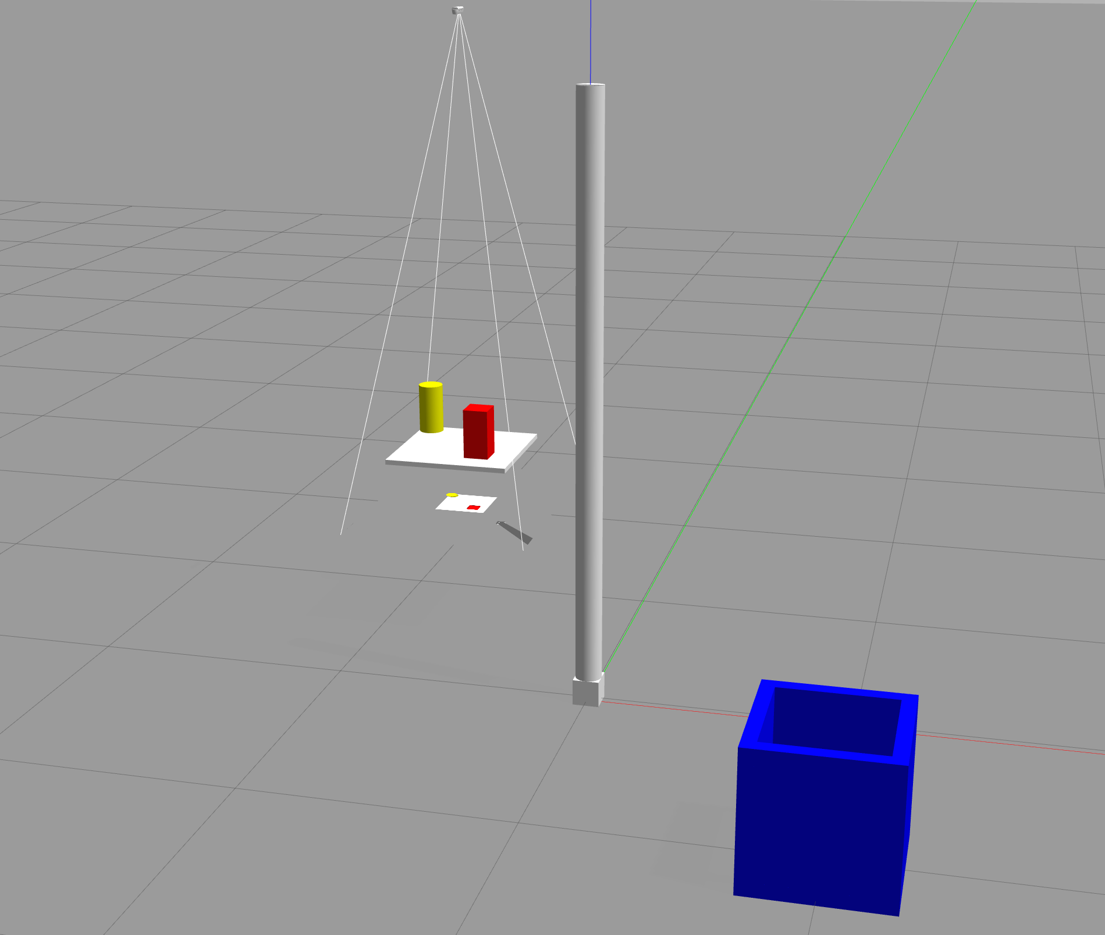
Laborprojekt Servicerobotik / Bildverarbeitung für Robotik 2024 Abschlusspräsentation Projekt 02: <Bin picking>
Bild
Bearbeiter: <Nan Jiang>

Slide 2
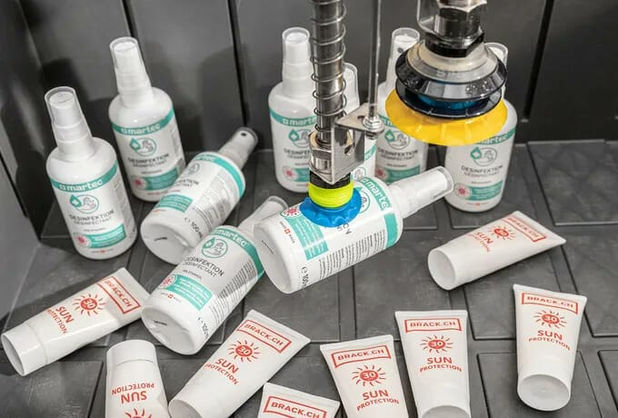
Motivation
Production Line Automation, Quality Inspection…
Efficiency
Safety

Slide 3
Concept
Bin picking in simulation
A simulation of 7 degrees of freedom robotic arm with integration of YOLO vision system

Slide 4
Concept
Virtual Camera
ROS
YOLO
ROS
Moveit!
ROS
Grasping in Gazebo

Slide 5
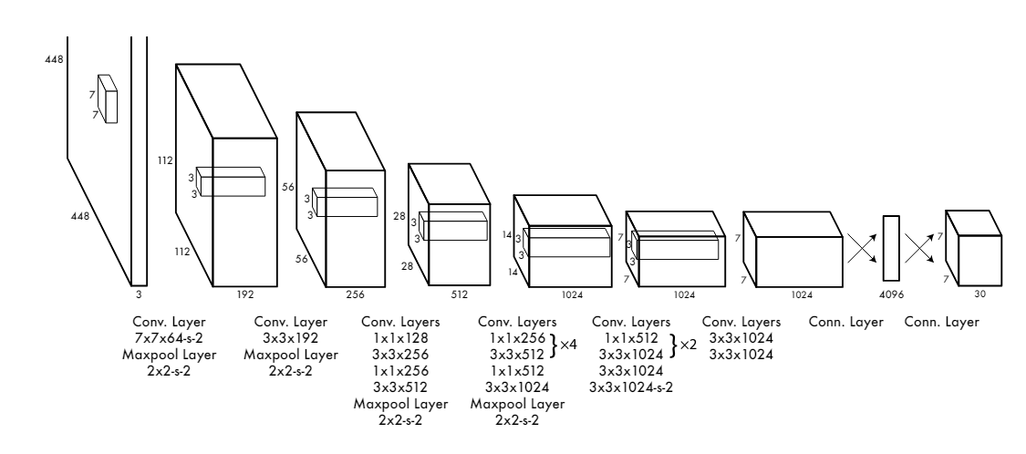
Methods and Algorithms
YOLOv5
Open Motion Planning Library (OMPL)
RRT(Rapidly-exploring Random Tree), RRTConnect…

Slide 6
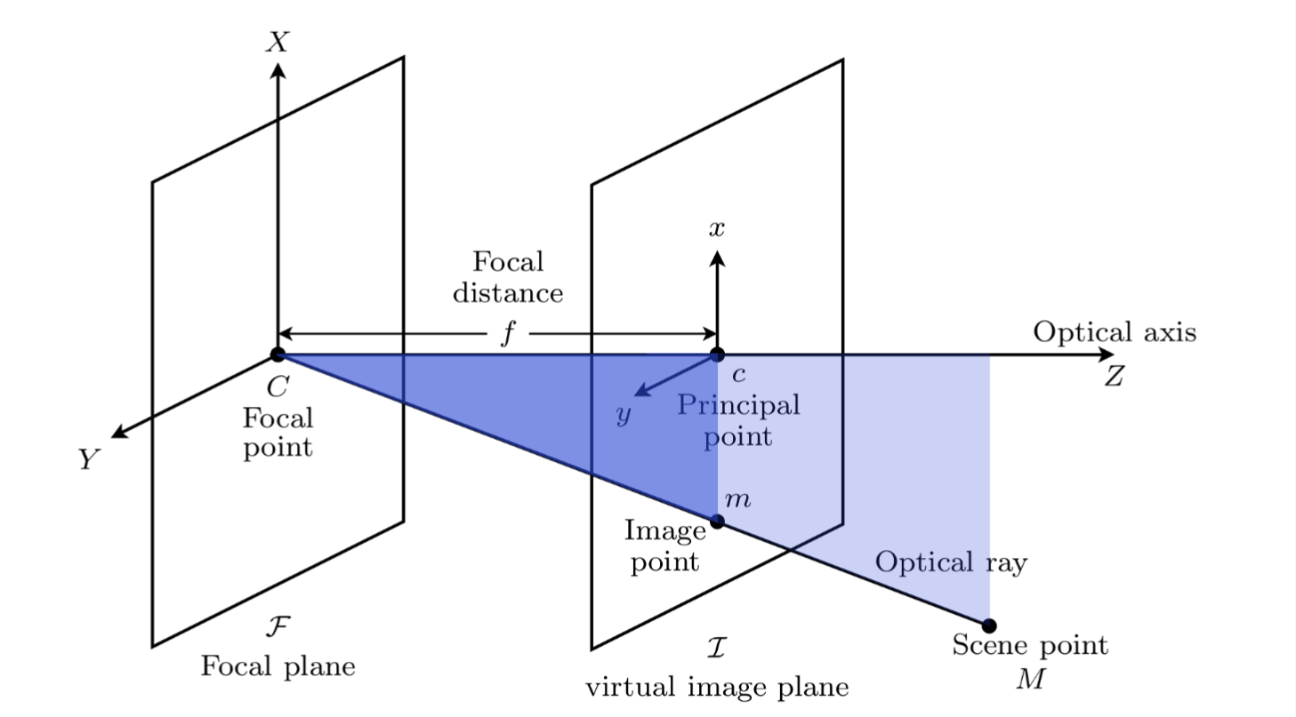
Methods and Algorithms
Pinhole model

Slide 7
Implementation
URUF file
Planning scene
YOLO object detection
Camera calibration
Gazebo simulation

Slide 8
Implementation
Environment setup

Slide 9
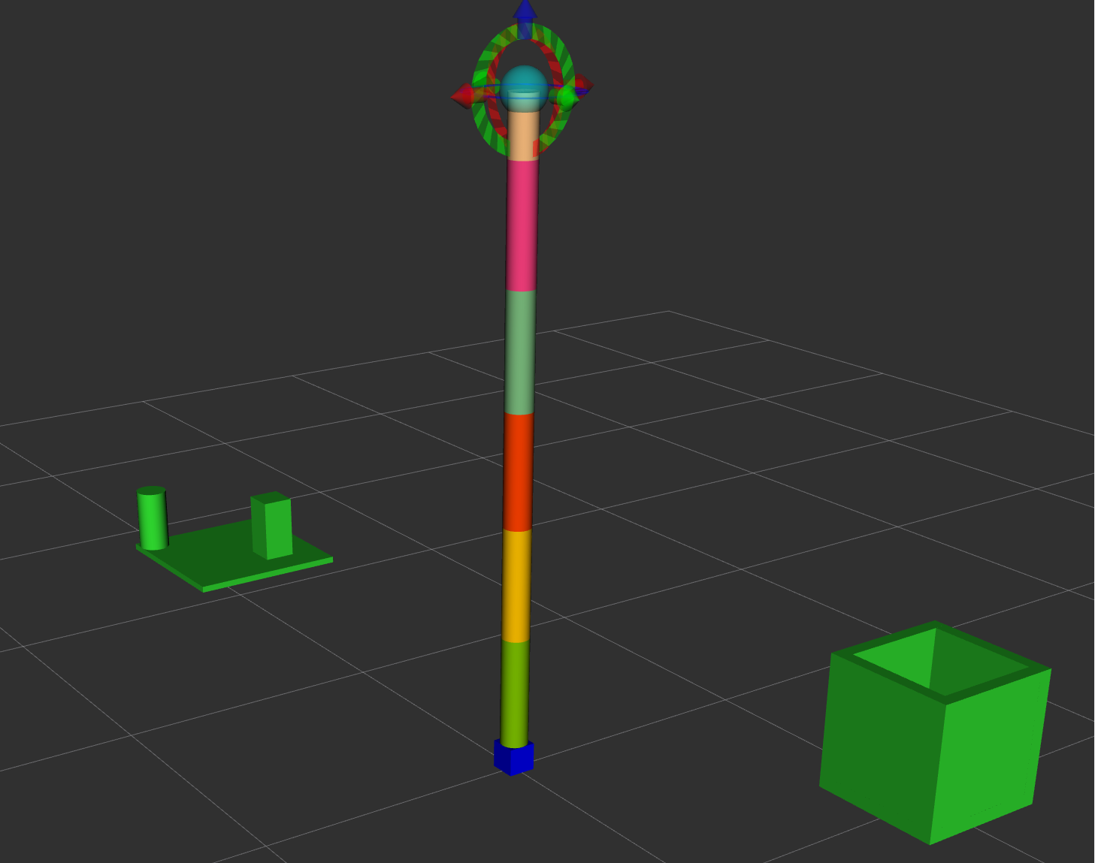
Implementation
Planning scene

Slide 10
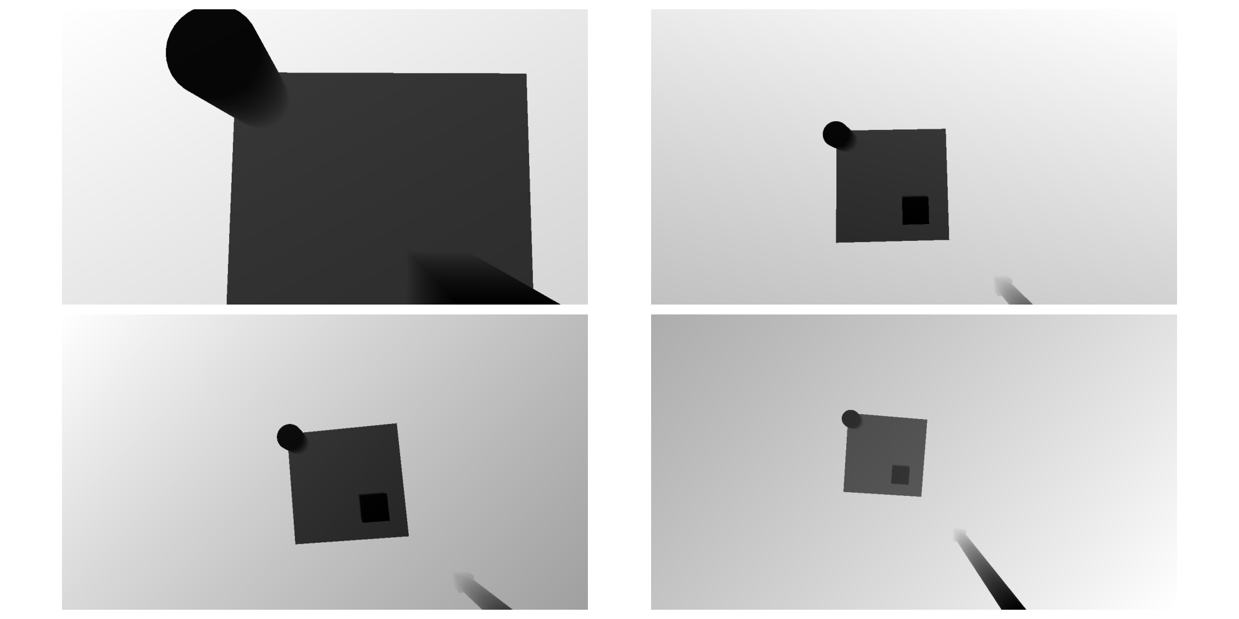
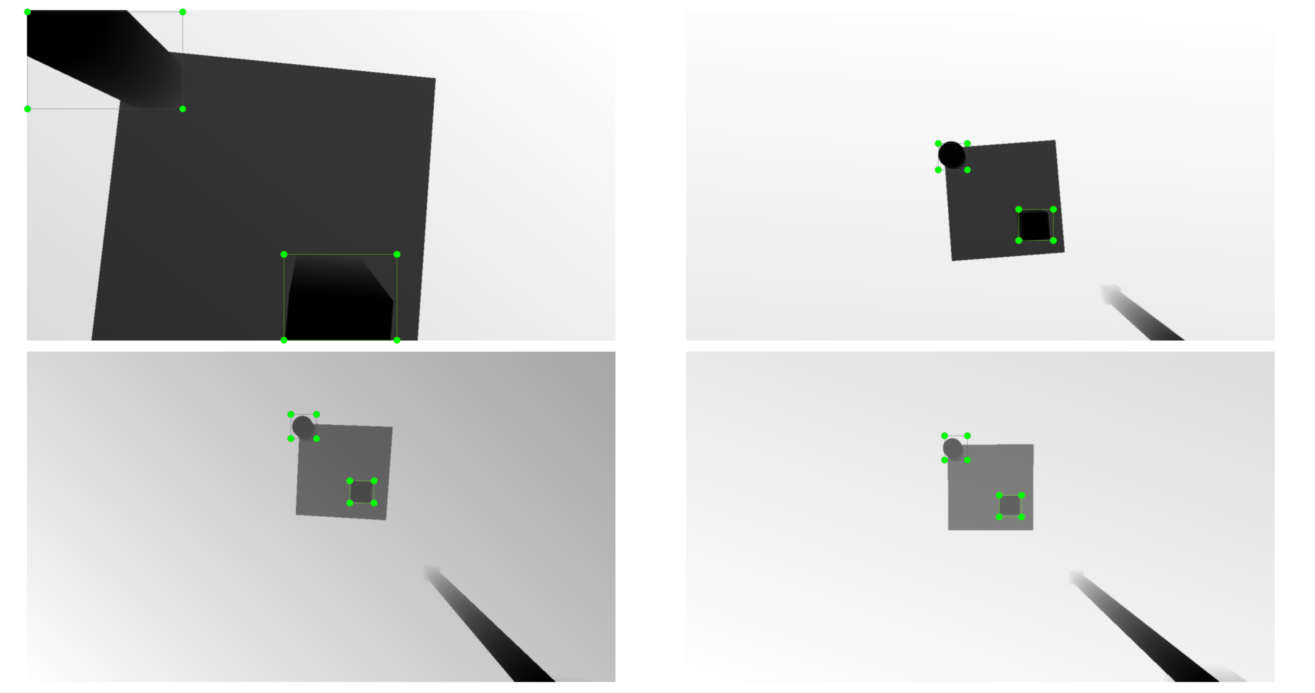
Implementation
Dataset
Labeling

Slide 11
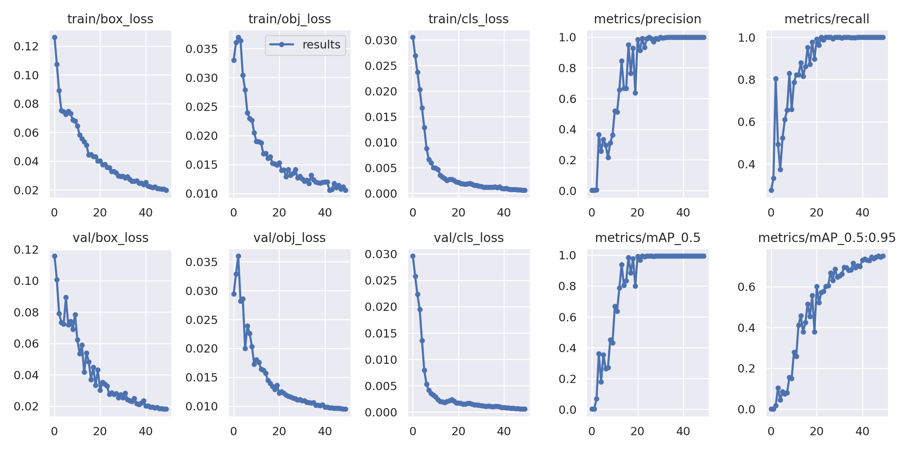
Implementation
Training process

Slide 12
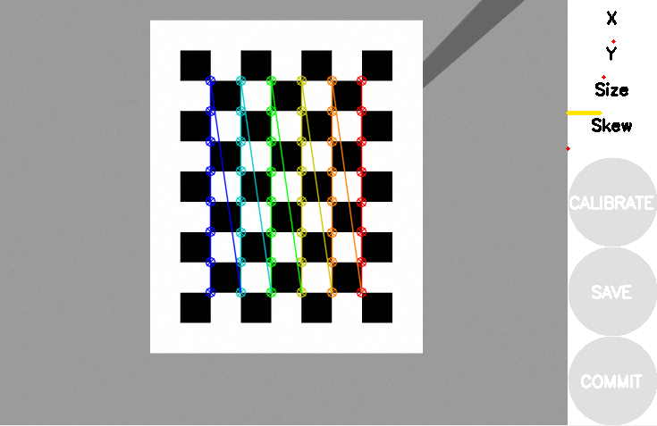
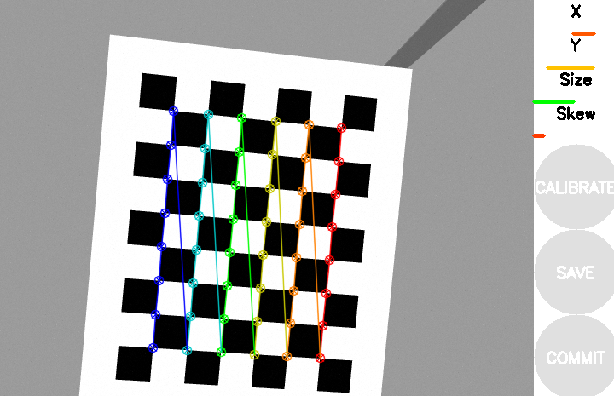
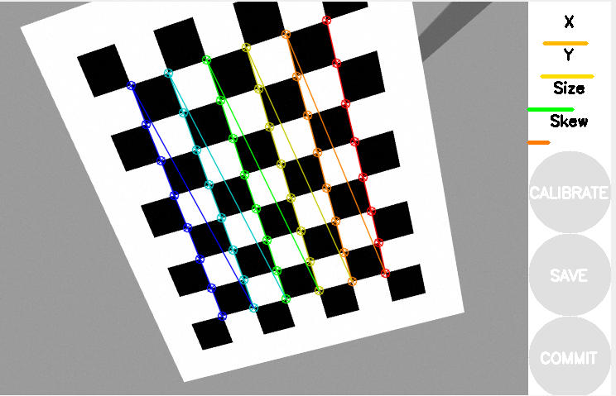
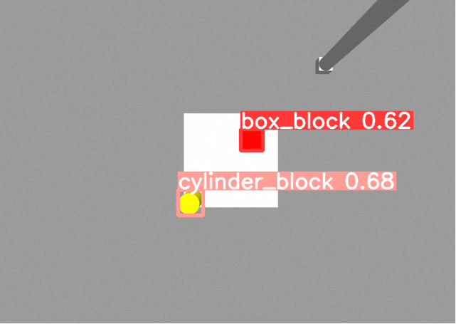
Implementation
Camera calibration
Detection

Slide 13
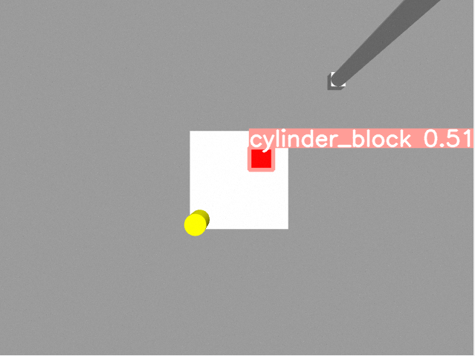
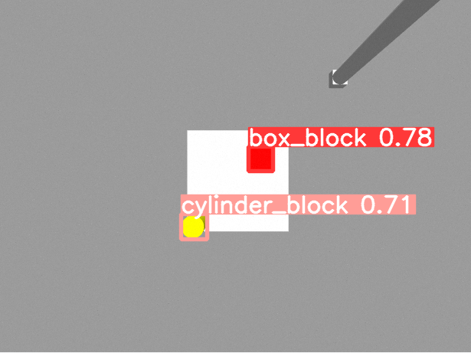
Experiment and Evaluation
The influence of the pre-trained model size
Yolov5n.pt Yolov5s.pt Yolov5m.pt

Slide 14
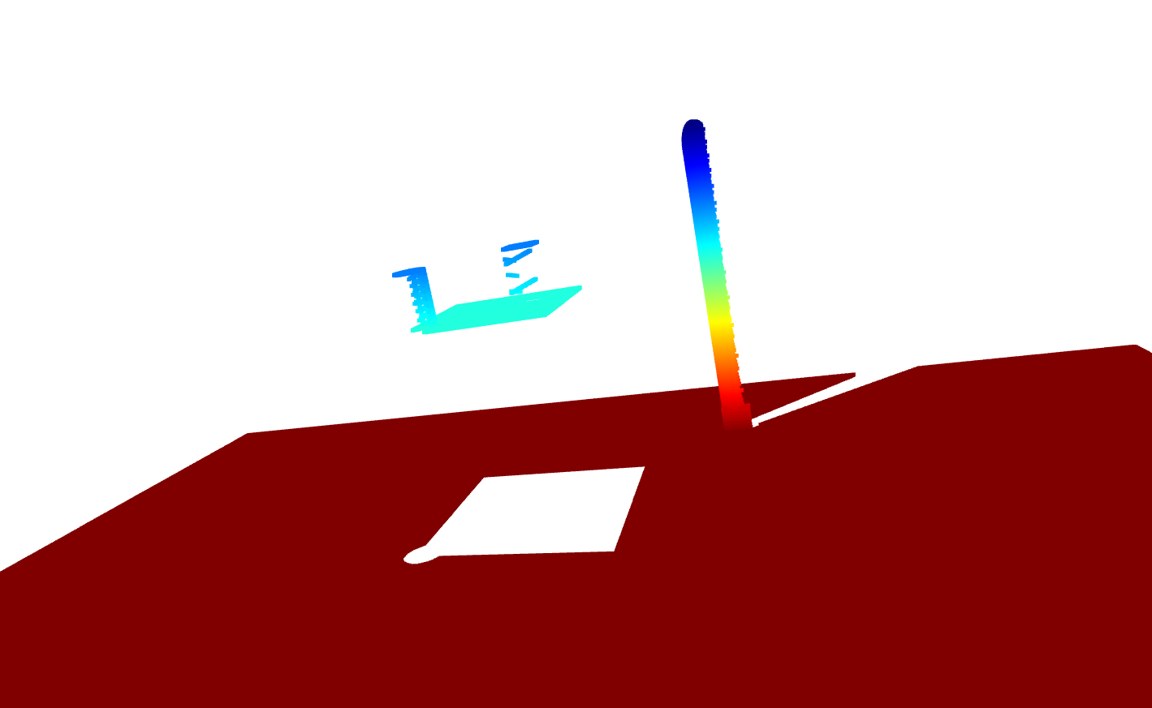
Experiment and Evaluation
Point cloud

Slide 15
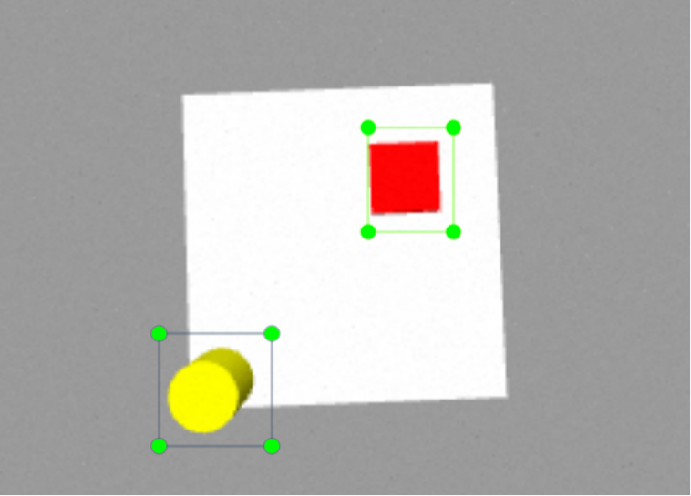
Summary and Outlook
Limitations: limited application senario
Future work:
More training data
Complexer senario

